Slide 1
Leading a Reinvention after Disruption

Slide 2
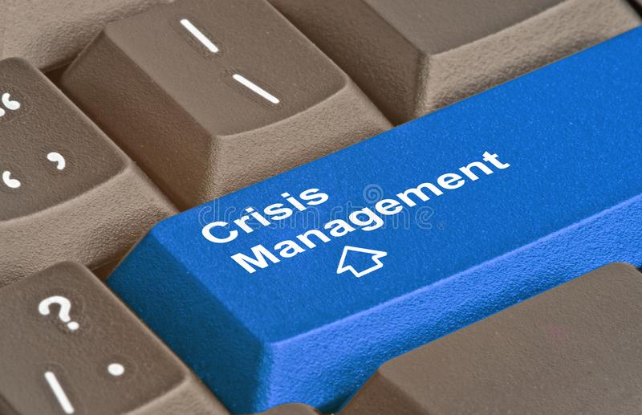
Disruption
Global impact
Pandemic
Business disruption
Shelter in place
Home school
Illness
Quarantine
Isolation
Economic impact
Media frenzy
Essential v non-essential employee
States respond differently

Slide 3
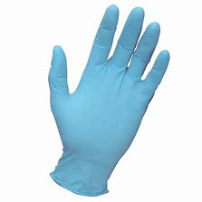
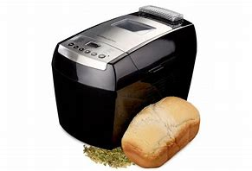
Recent Trends
Economic volatility
E-Commerce
Fastest incline/ decline
Remote work
Increase 28% to 53%

Slide 4
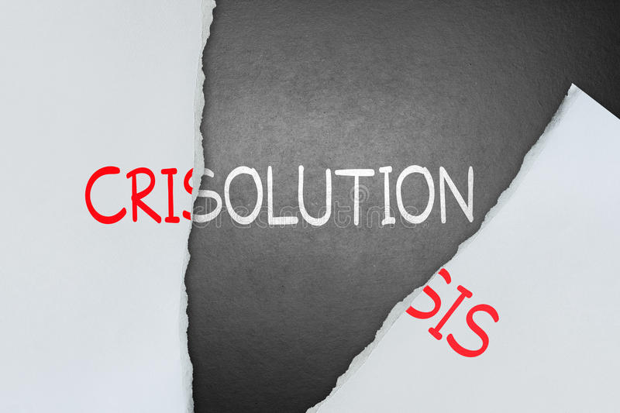
WHAT’S NEXT?
REINVENTION

Slide 5
Reinvention Steps
Debrief
Plan
Actions taken
Impact of the actions
Lessons learned
Successes
Self-management
Employee engagement
Team building
Business process improvements
Change management

Slide 6
Self Management

Slide 7
Self Management Actions
Do an honest assessment through reflection
Ask a trusted advisor for feedback
Track your time and energy

Slide 8
Employee and client engagement
Meet them where they are

Slide 9
Employee Engagement Actions
Build an on-ramp back to work and re-assimilate staff
Welcome and thank each person individually
Celebrate any milestones or events that were missed
Ask them to reflect personally
Talk to them how things have changed
Draft individual development plans for future training/ readiness
Determine how to bring in some practices to retain to everyday

Slide 10
Client Engagement
Understand their business changes / needs
Share any impacts your company has experienced
Share new services you are providing
Discuss any changes to the future relationship

Slide 11
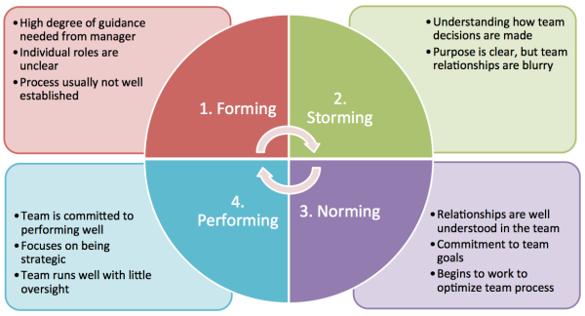
Team Building

Slide 12
Team Engagement Actions
Bring the team together for a lunch or meal
Facilitate a normalizing session for your team
Address the different contributions
Address any changes that may have occurred
Conduct a SWOT
Determine development for team
Reset expectations and code of conduct

Slide 13
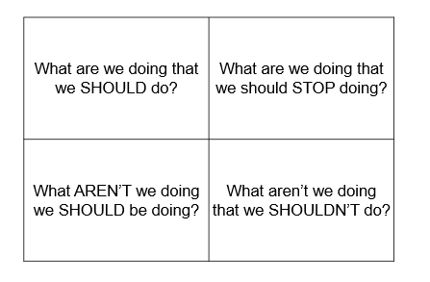
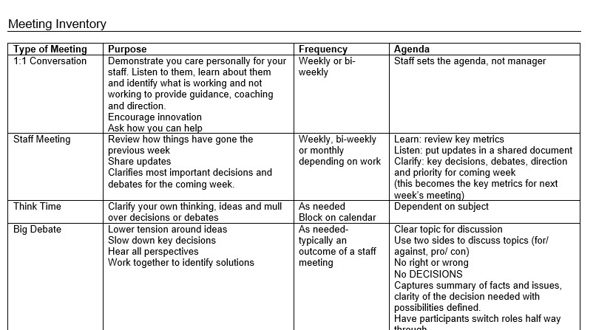
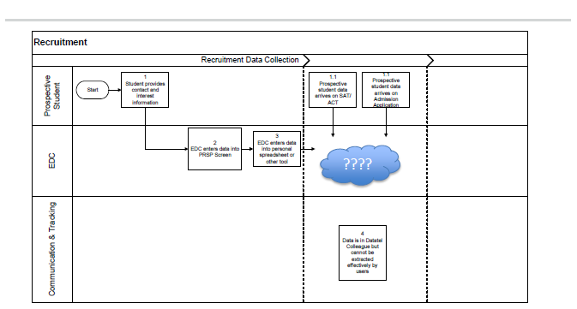
Business Process Improvement
Meeting Inventory
Critical Thinking
Process Mapping
Brainstorming
Sticky note

Slide 14
Business Process Improvement Actions
Use successes and lessons learned for direction
Inventory and adjust meetings
Leverage communications
Use process mapping for continuous improvement

Slide 15
Action Plan
Conduct an after-action review for your organization
Outcome: Successes and Lessons Learned
Assess self- behaviors and attitudes
Outcome: Adjust habits
Have candid conversations with your staff
Outcome: Reset expectations
Conduct a team meeting
Outcome: Normalize the team
Assess business processes
Outcome: Process improvements
Reinvention

Slide 16
Resources
Mindy Price-
614-214-6227
Mindy.Price@DirectEffectSolutions.com
Coursera- free and subscription online college curricula
https://www.coursera.org/
Linkedin Learning (often free through your local library)
FDOT telework training resources http://telework.fl.gov

